Slide 1
Redux
Nov 2016

Slide 2
Agenda
State and Prop revisited
Redux Principles
Redux Component
Redux Flow
Practice: Bank Account
Practice: Air Cheap

Slide 3
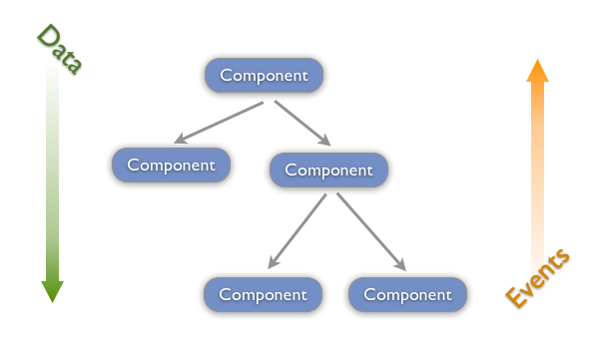
One-Way Data Flow

Slide 4
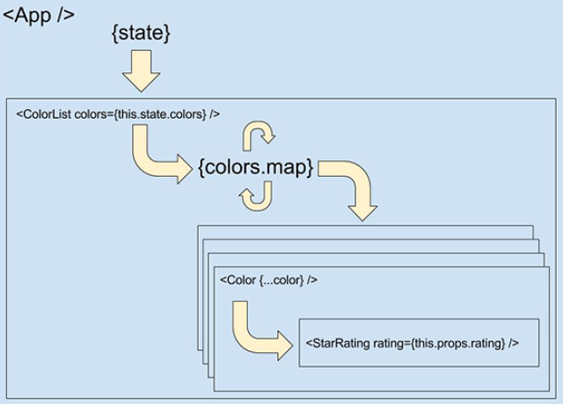
State is Passed as Properties
Notes:
State is passed from the App component to child components as properties

Slide 5
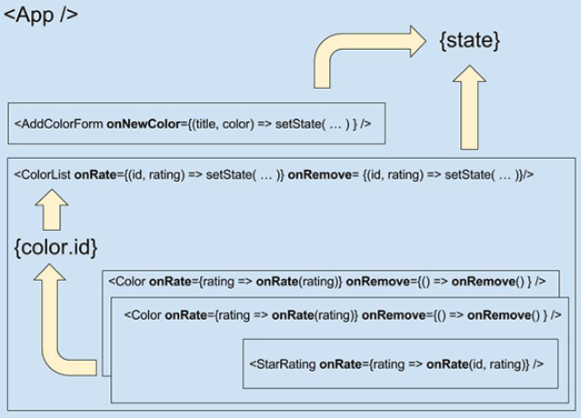
Passing Data Back up to Root
Notes:
Passing data back up to the root component when there are UI events

Slide 6
Redux 3 fundamental principles
Single source of truth
The state of your whole application is stored in an object tree within a single store.
State is read-only
The only way to change the state is to emit an action.
Changes are made with pure functions
To specify how the state tree is transformed by actions, you write pure reducers (no side effect, no mutation)

Slide 7
Redux Component
Main component:
Store
Action
Reducer
Additional:
Middleware

Slide 8
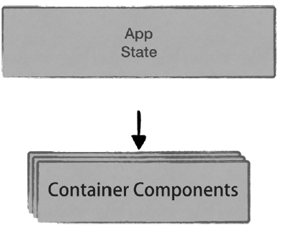
Store
Store
Notes:
Our ideal view of the world looks like this figure. Data is completely separated from the component, but you want the component to be notified when data changes so it can rerender.
That's exactly what is achievable by using Redux. Redux provides a store to hold the entire application state in a single, centralized JavaScript object. The store can be directly accessed by any container components in the
application

Slide 9
Store Functions
• getState
Read the current state from the store.
• subscribe
React Container components can subscribe to the store to be notified of state changes and re-render themselves - as well as their children.
• dispatch
Used to dispatch an action to the store. Dispatched actions are used to trigger state changes.

Slide 10
Actions
Store
Action
Notes:
Obviously there are many circumstances where you might want to change the state in the store:
Whether as a result of user interactions (such as: clicking on a button, leaving a comment, requesting search
results and so on...) or as result of AJAX requests, timers, web socket events etc. So how to change the state ? Using dispatch actions.
Dispatching an action is like sending a message to the store saying that something happened and that
the store should update itself in response

Slide 11
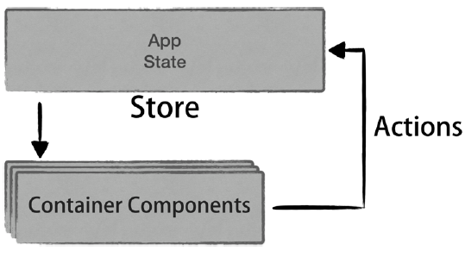
Actions - Rendering
Render
Notes:
React container components dispatches actions to the store to indicate that something that impacts application state happened (say, when the user clicks on a button);
The store updates its own state and notify the subscribed components; Container components re-render the UI
with the latest data.

Slide 12
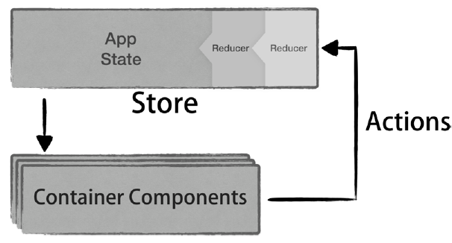
Reducer
Reducer
Notes:
Reducer responsible for mutating the store state when actions are dispatched.

Slide 13
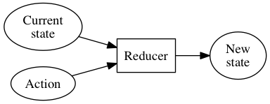
Reducer
Notes:
But what exactly is a reducer function? To put it in the simplest possible terms, a reducer is a function
that calculates a new state given the previous state and an. When you instantiate your application’s store, you pass one (or more) reducer functions. These functions will be
called every time an action is dispatched and their jobs is to calculate the new, updated state.

Slide 14
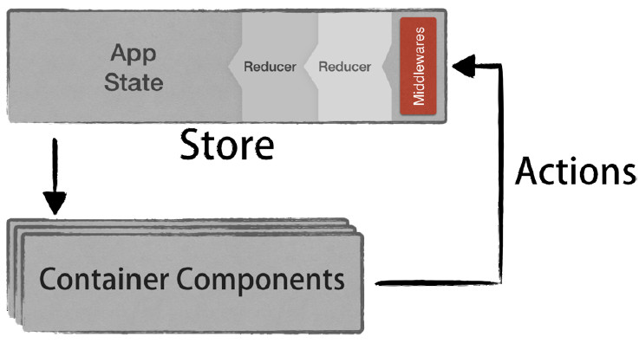
Middleware
Notes:
Middleware provides a third-party extension point between dispatching an action, and the moment it reaches the reducer. Various use of Middleware: logging, crash reporting, talking to an asynchronous API, routing, and more.

Slide 15
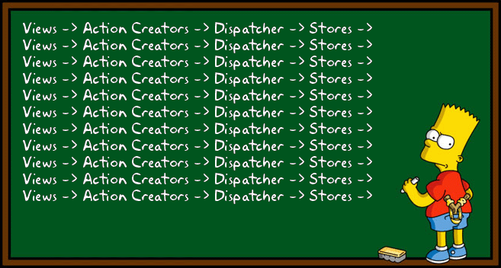
Redux Essentials

Slide 16
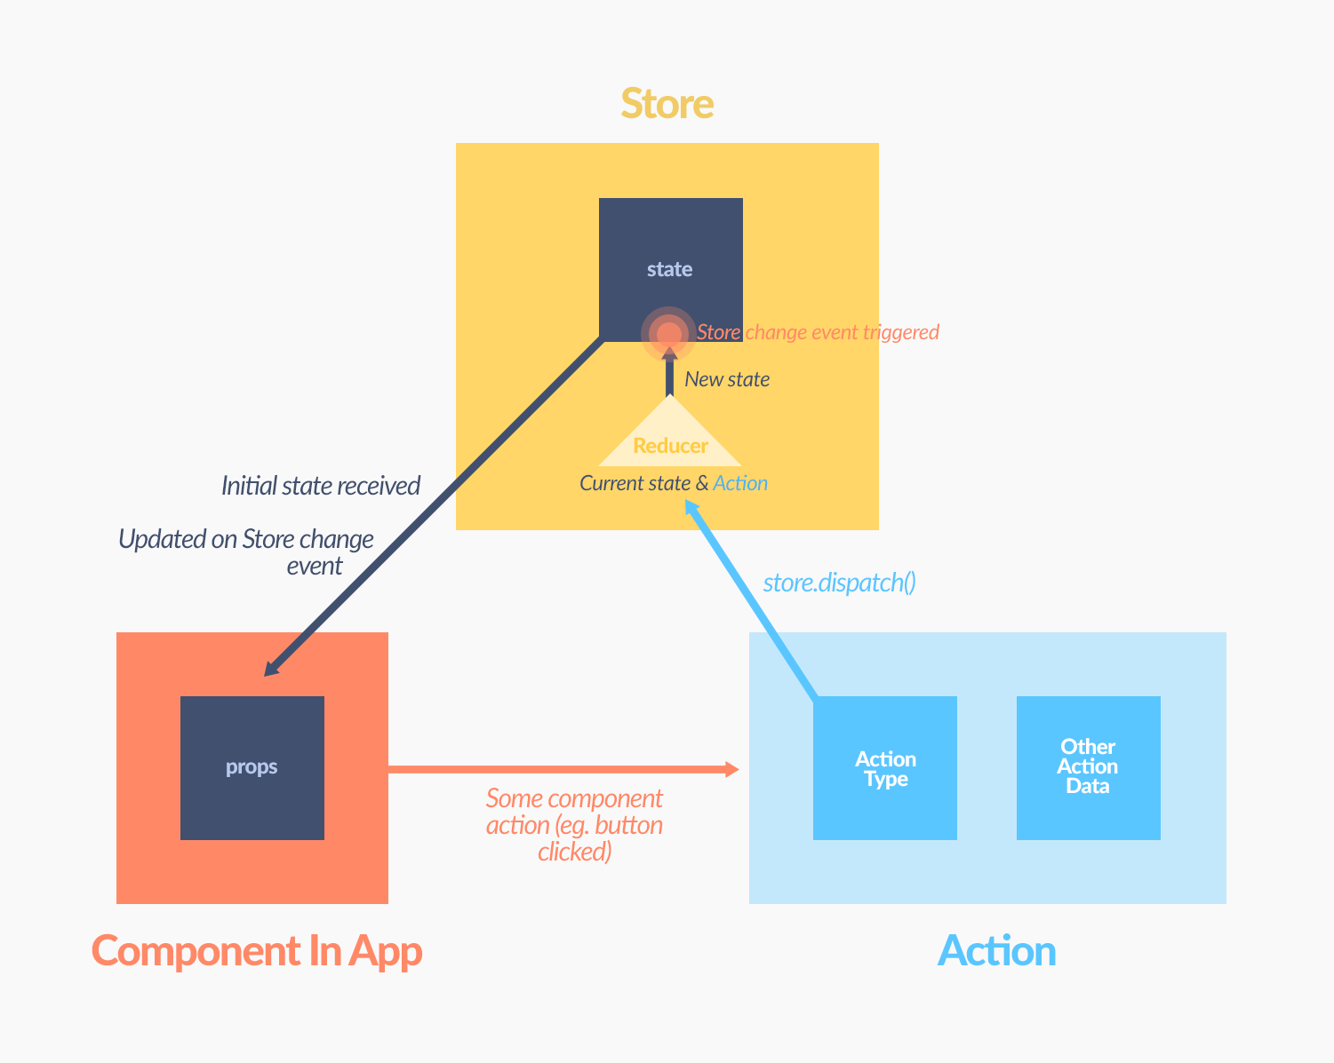
More Redux Diagram (1)

Slide 17
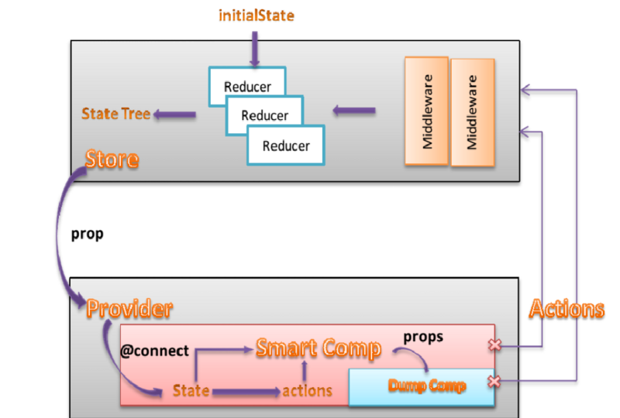
More Redux Diagram (2)

Slide 18
More Redux Diagram (3)

Slide 19
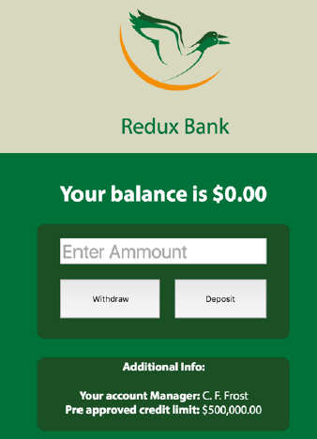
Practice: Redux Bank

Slide 20
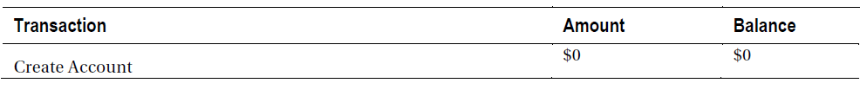
Practice: Redux Bank Initial State

Slide 21
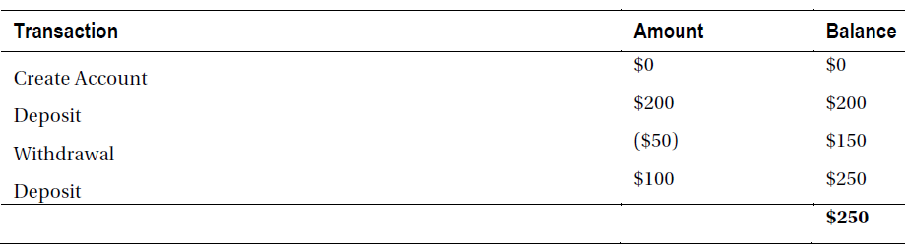
Practice: Redux Bank Example Transaction
Action
State

Slide 22
Practice: Redux Bank File Structures
• A constants.js: Since all actions should have unique names (“types”, to be precise), and those names will be referenced across the app, we will store them as constants.
• bankReducer.js: The app will have a single reducer function that will be used by the store.
• bankStore.js: Instantiate a Redux store (which will keep track of the user’s balance) using the reducer function.
• The App.js file, which contains both the presentational component and a container component we will use in this project.
Notes:
A constants.js file: Since all actions should have unique names (“types”, to be precise),
and those names will be referenced across the app, we will store them as constants. This
is not mandatory nor it’s a Redux requirement, but rather a good practice to use every
time you need to provide uniquely identifiable names across the application.

Slide 23
Asynchronous Action Creators
Redux dispatches are synchronous: Every time a dispatch happens, all registered reducers are immediately invoked with the dispatched actions. Remember that actions are just plain JavaScript objects with a “type” field and optional data:
{ type: ACTION_TYPE, result: 'whatever' };
This raises a question: How to deal with asynchronous operations (such as data fetching, for example) in Redux?
The answer is provided by Redux in the form of a middleware: Redux-thunk.

Slide 24
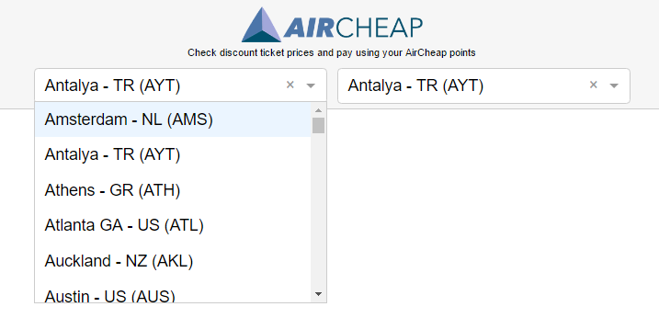
Practice: Air Cheap

Slide 25

Special Thanks
http://redux.js.org
http://slides.com/danabramov/components-react-flux-wip
http://bumbu.me/simple-redux/
https://www.youtube.com/watch?v=Td-2D-_7Y2E Redux Async Actions - Redux Tutorial #6
Apress, Pro React, 2015, Cassio de Sousa Antonio

